Slide 1

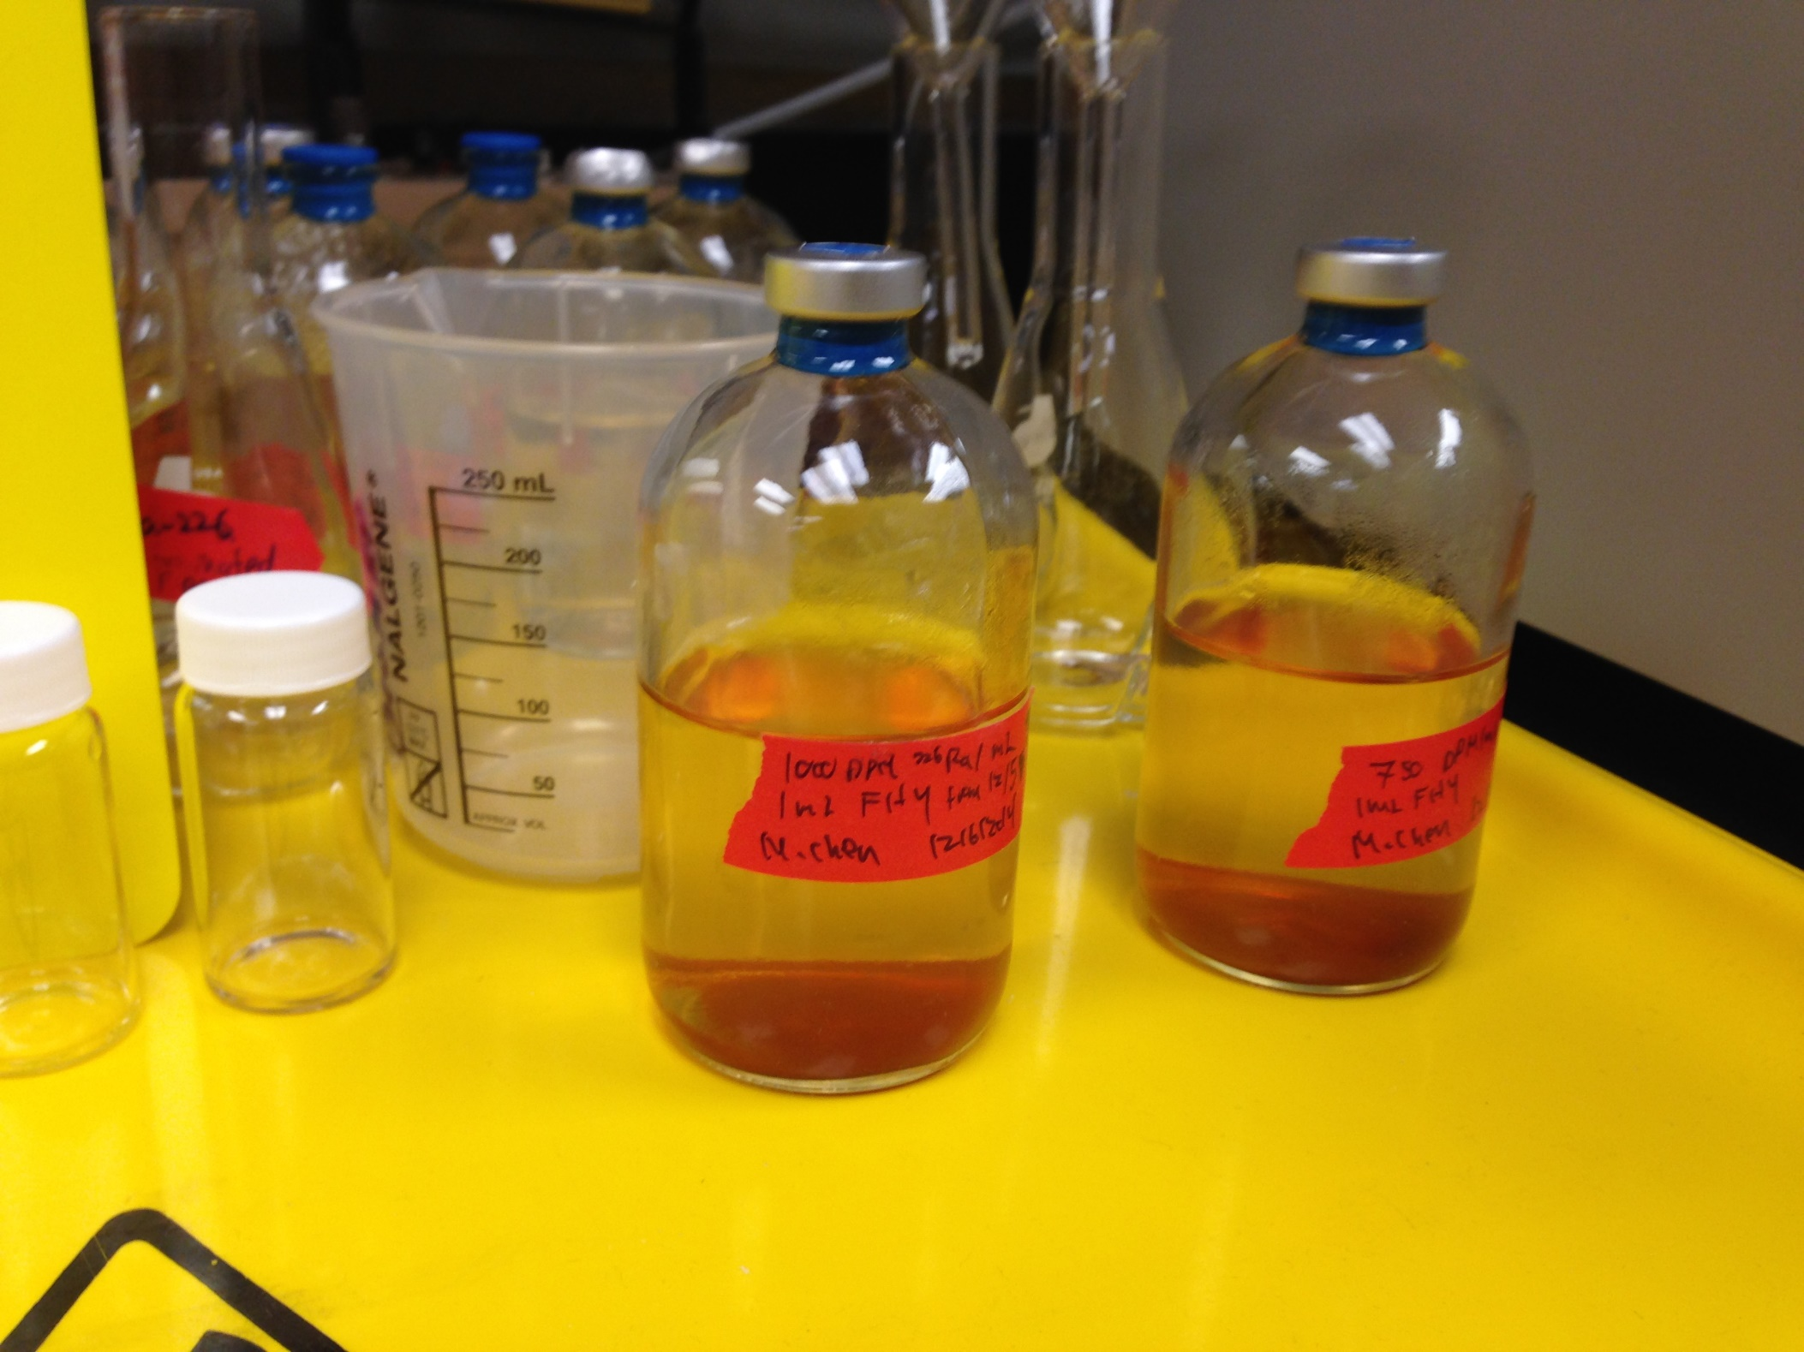
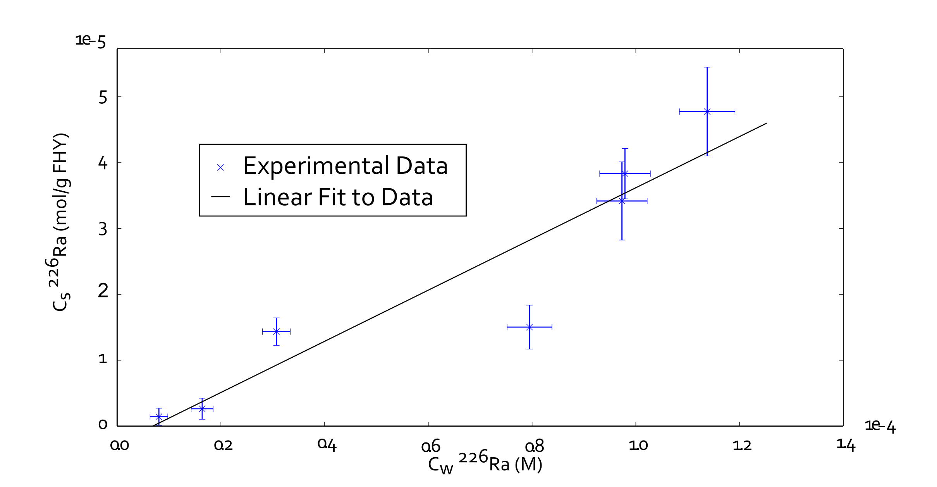
Radium Adsorption to Iron Bearing Minerals
AGU Fall Meeting 2014
Michael Chen, Benjamin Kocar
Abstract No: H11A-0841
Civil and Environmental Engineering, Massachusetts Institute of Technology, Cambridge, MA, United States
For more information, contact:
machen@mit.edu
I. Introduction and Objectives
II. Experimental Methods
Introduction: Radium (Ra) is a ubiquitous, naturally occurring radioactive element typically found at low concentrations within soils, sediments, and aquifers (< 5 mBq/L or 50 mBq/g). Although there is continued, limited use of Ra in medicine and some industrial processes, the commercial use of Ra decline markedly >50 years ago. Nevertheless, there is growing interest in the environmental fate of Ra due to its properties as a (re)-emerging contaminant and as a tracer used in hydrologic studies.
Elevated radium (highest concentrations observed in excess of 300 Bq/L) is often found in hydraulic fracturing produced water (waste), which could be released to soil and aquifer systems following accidental discharge or seepage.
Radium isotopes have been used as tracers for submarine groundwater discharge (SGD); water discharge/flux calculations have been based on the use of Ra isotope activities.
Objectives: The overarching objective of our work is to decipher critical parameters governing Ra transport in the environment, including complexation with surfaces of common soil-aquifer minerals and fate and transport associated with fluctuating redox conditions (mineralogical transformations). Here, we present preliminary data illustrating Ra adsorption to ferrihydrite, a ubiquitous iron-bearing mineral.
Procedure
Synthesize Ferrihydrite by dissolution of FeCl3 6 H2O in water, titration to a stable pH between 7-8, extraction and washing via centrifuge, and then adding water to make an FHY slurry
Slurry iron content measured via ICP-MS
Fresh slurry made every 1.5 weeks
Fill glass serum bottles with 1 mL FHY slurry, water, and varying amounts of ²²⁶Ra stock. (Standardized to 370 Bq per g of stock)
Some experiments take 2 mL sample for scintillation
Stopper bottles with butyl stopper and aluminum crimp cap, shake for 24 h
Measure pH and filter solution through 0.2 µm glass fiber syringe filter
Scintillation count total Radium and daughter products with 2 mL of filtered solution and 8 mL Ultima Gold XR
Experiment parameters
Slurry Iron Concentration = 13.3 ± 1.2 g/L
Solution Volume: 100.00±0.01 mL
Solid-Solution ratio: 0.13±0.01 mg/mL
Total ²²⁶Ra activities: 83 Bq, 167 Bq, 417 Bq, 833 Bq, 1250 Bq, 1667 Bq
Experiments performed at pH 3.5
24 hour shake time
Counting efficiency: 43%
III. Preliminary Results
C_{w} found using sample taken in step 5
C_{s} found two ways:
C_{s} = C_{Step2} – C_{w} if available
Otherwise, C_{s} = V_{stock}C_{stock}-C_{w}
Error bars represent propagated analytical uncertainty
Linear fit done with NumPy polyval()
K_{d} = 0.39 L/g, R² = 0.87
Image: Two serum bottles after a sorption experiment
IV. Conclusions and Future Work
Data is well-described with a linear (K_{d}) isotherm.
Appreciable ²²⁶Ra adsorption to ferrihydrite was observed, and is comparable to other important sorbents of Ra, including quartz (K_{d} ranging from 0.2 L/g to 10 L/g for quartz sands).
Surface complexation modeling of radium to ferrihydrite with pH control
Additional isotherms with variations in solution composition closer to environmentally relevant conditions
Additional isotherms with Si and Fe-bearing minerals
Column studies examining Ra partitioning with specific minerals under dynamic redox conditions.

